Slide 1
基于原地卷积网络的前端信号处理算法
张学良
(合作者：刘晋江，张成刚）
内蒙古大学，计算机学院
语音信号处理组

Slide 2
提纲
背景
原地卷积网络 inplace convolutional recurrent network
基于原地卷积网络的多通道语音增强
基于原地卷积网络的声学回声消除
基于原地卷积网络的混响消除 dense recurrent convolutional network
总结

Slide 3

背景
背景噪声
干扰人声
房间混响
设备播放的声音
噪声抑制
混响消除
声学回声消除
语音通讯
自动语音识别
助听器设计

Slide 4
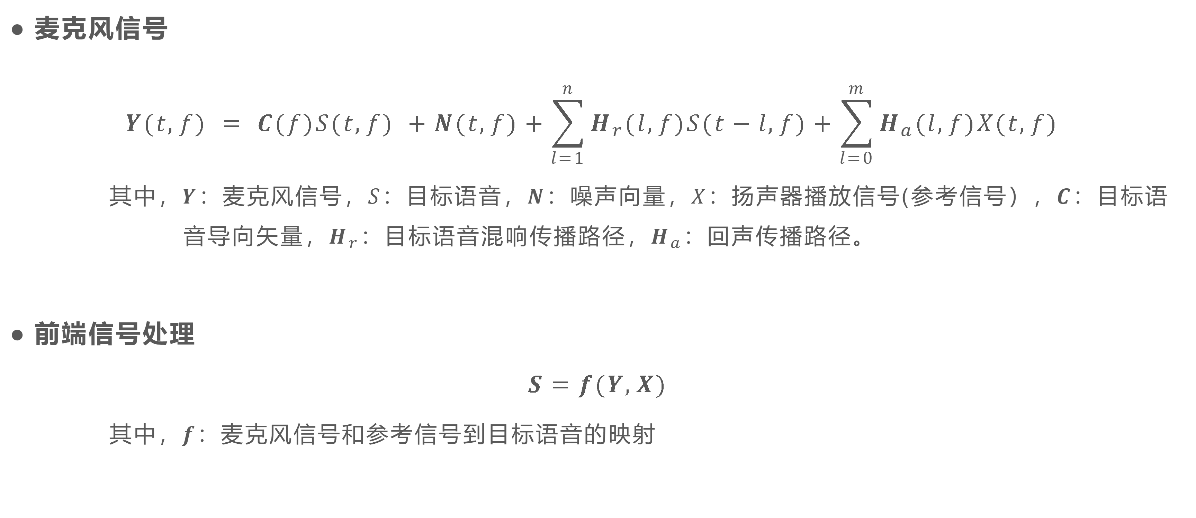
背景
麦克风信号
$$Y(t,f) = C(f)S(t,f) +N(t,f)+\sum_{l=1}^{n}{H_{r}(l,f)S(t−l,f)}+\sum_{l=0}^{m}{H_{a}(l,f)X(t,f)}$$
其中，$Y：$麦克风信号，$S：$目标语音，$N：$噪声向量，$X：$扬声器播放信号(参考信号），$C：$目标语
音导向矢量，$H_{r}：$目标语音混响传播路径，$H_{a}：$回声传播路径。
前端信号处理
$$S=f(Y,X)$$
其中，$f：$麦克风信号和参考信号到目标语音的映射

Slide 5
传统信号处理 VS 深度学习
 | 传统信号处理 | 深度学习
单通道降噪 | 维纳滤波 | CRN^{[1]} + 单mic输入
多通道降噪 | MVDR | CRN^{[2]} + 多mic输入
声学回声消除 | LMS | CRN^{[3]} + mic和ref输入
混响消除 | WPE | CRN^{[4]} + 单/多mic输入
深度学习：大数据量+大模型
泛化性问题
模型复杂度高
*CRN：Convolutional Recurrent Network
[1] Tan K. and Wang D.L. (2018): A convolutional recurrent neural network for real-time speech enhancement. Proceedings of INTERSPEECH-18, pp. 3229-3233.
[2] Tan K., Wang Z.-Q., and Wang D.L. (2022): Neural spectrospatial filtering. IEEE/ACM Transactions on Audio, Speech, and Language Processing, vol. 30, pp. 605-621.
[3] Zhang H., Tan K., and Wang D.L. (2019): Deep learning for joint acoustic echo and noise cancellation with nonlinear distortions. Proceedings of INTERSPEECH-19, pp. 4255-4259.
[4] Wang Z.-Q. and Wang D.L. (2020): Multi-microphone complex spectral mapping for speech dereverberation. Proceedings of ICASSP-20, pp. 486-490.

Slide 6
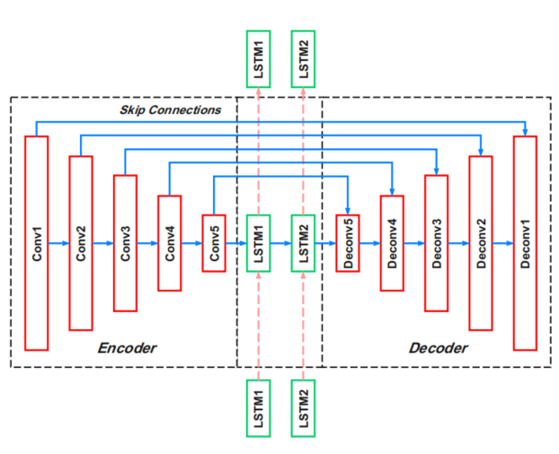
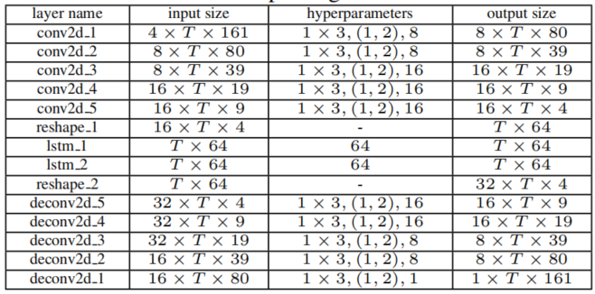
CRN
Frequency dimension
Encoder（多层卷积）+ LSTM + Decoder（多层反卷积）
全频带建模
Gated CRN、Dense CRN等

Slide 7
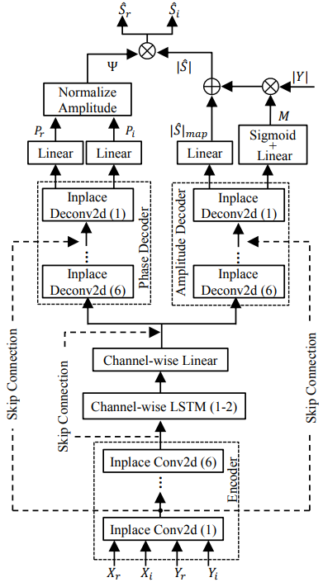
原地卷积网络
卷积层不做降采样
反卷积层不做升采样
采用channel-wise LSTM，每个频点的特征单独输入LSTM中
所有频点共享一个LSTM
（以此实现频带间的独立处理）
采用复数谱作为整个网络输入
同时预测网络幅度和相位

Slide 8
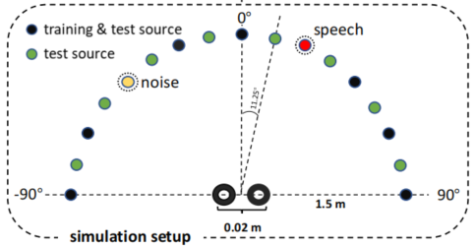
基于原地卷积网络的多通道语音增强
Speech：
AISHELL-1 (Mandarin): Training(29 hours), Validation(1 hour)
TIMIT : Test
Noise:
NOISEX92: Test (destroyerops, white, and babble) Train(rest 12 type of noises)
Location： IMAGE method
9 for training with 22.5◦ interval
17 for test with 11.25◦ interval.
Microphones:
Room center with 2cm interval
Evaluation metrics:
Short-time objective intelligibility (STOI)
Perceptual evaluation of speech quality (PESQ)
Signal-to-distortion ratios (SDR)
Jinjiang Liu and Xueliang Zhang, “Inplace Gated Convolutional Recurrent Neural Network for Dual-Channel Speech Enhancement,” in Proc. Interspeech 2021, pp. 1852–1856.

Slide 9
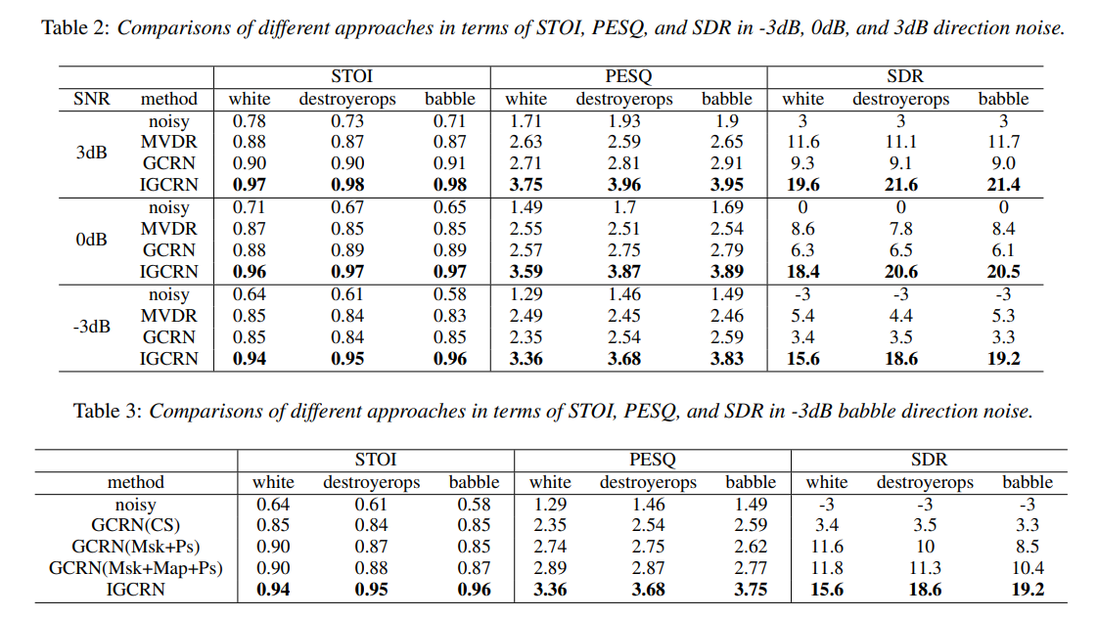
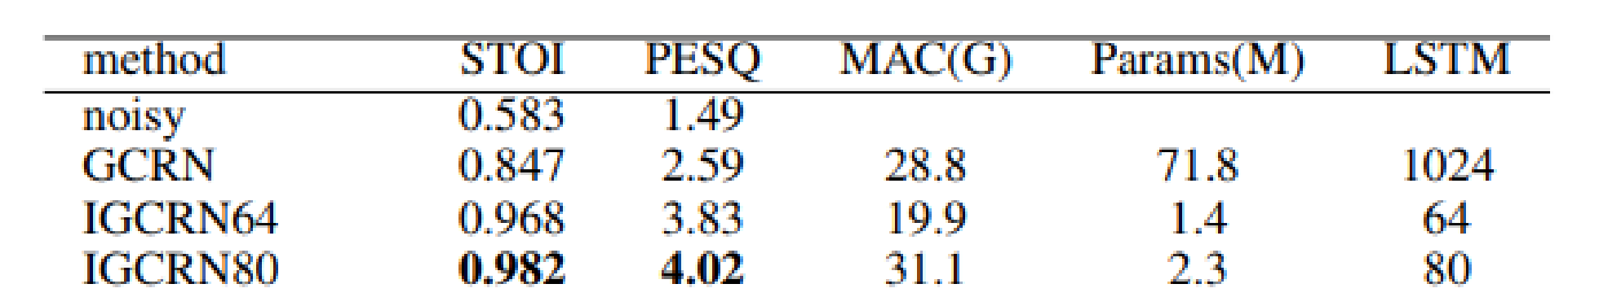
结果
* MVDR的结果基于真实方向

Slide 10
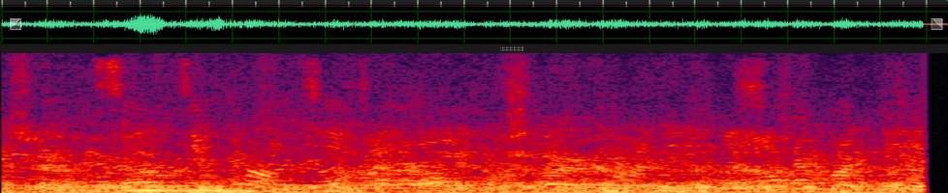

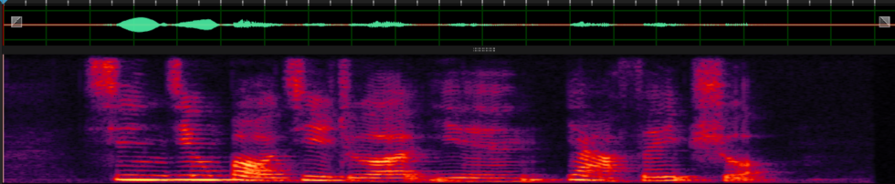
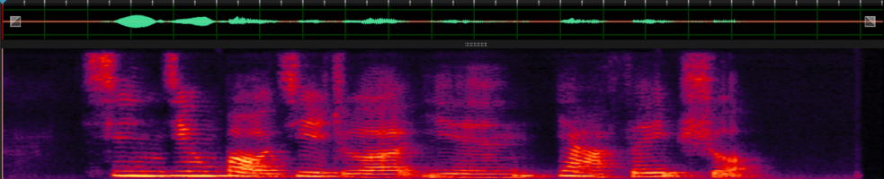
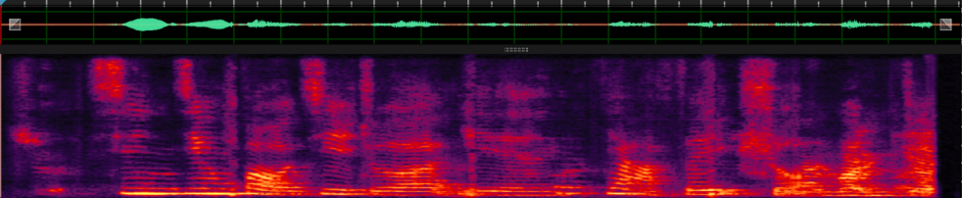
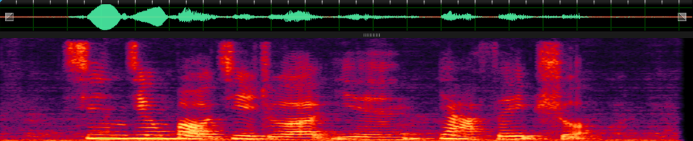
mixture
clean
IGCRN
GCRN
MVDR
Notes:
4nd, we test how the downsampling influnce the perfermance, as we can see when the downsampling time increase the performance gradually decay.

Slide 11
基于原地卷积的声学回声消除
Training
200 pairs of speakers fromTIMIT corpus which contains 630 speakers
rooms of size l × w × h, l [4m,10m] , w [5m,11m] , h [3m,4m].
distance between mic and loudspeaker [0.5, 0.7, 0.9]m.
T60 [0.2, 0.3, 0.4, 0.5, 0.6]s, 10,000 RIRs are created.
SER randomly chosen from [-9, -6, -3, 0, 3, 6, 9] dB.
30,000 mixtures for training and 2,000 for validation.
Test
Testing room = [4, 5, 3]m, T60=0.35s. distance 0.6 m.
Choose unseen 100 pairs of speakers for testing.
Evaluation Metric
ERLE: 度量回声残余
PESQ: 近端信号保真度

Slide 12
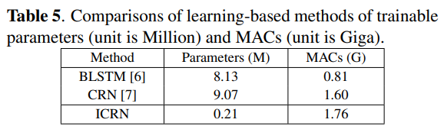
结果
Chenggang Zhang, Jinjiang Liu and Xueliang Zhang, “A Complex Spectral Mapping with Inplace Convolution Recurrent Neural Networks For Acoustic Echo Cancellation,” ICASSP 2022, pp: 751-755.

Slide 13
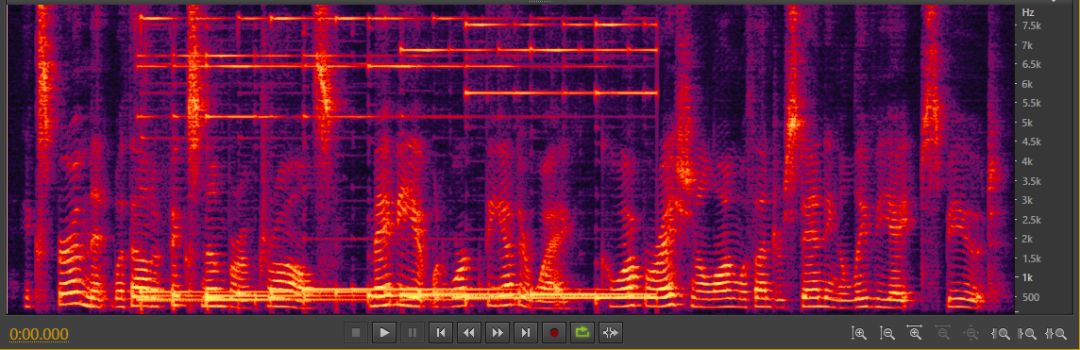
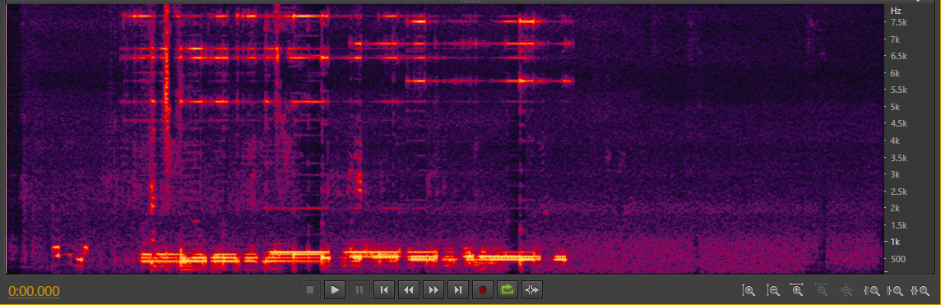
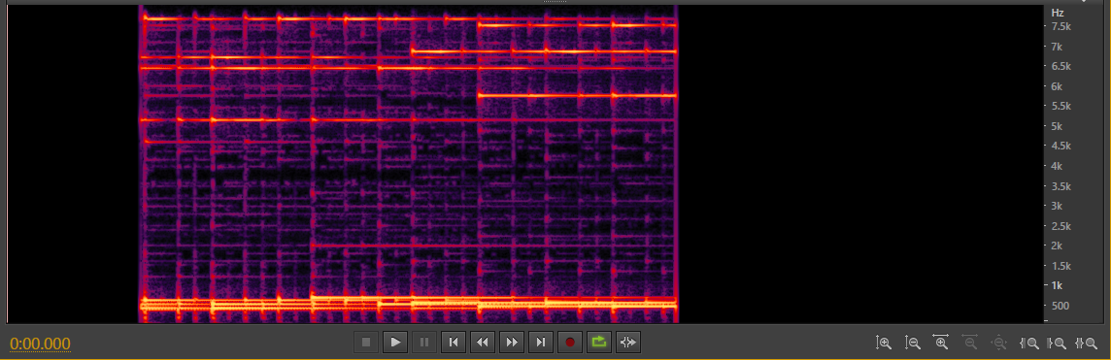
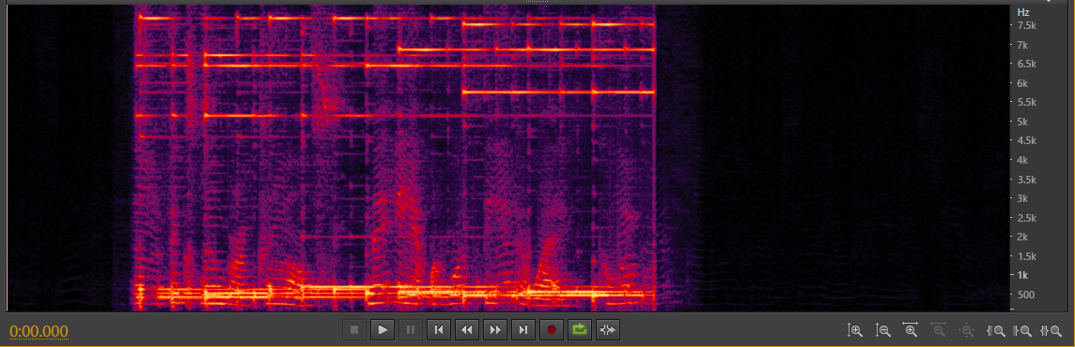
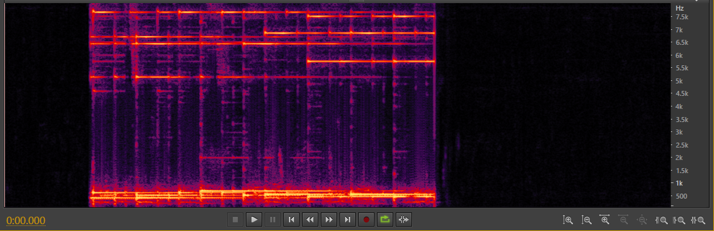
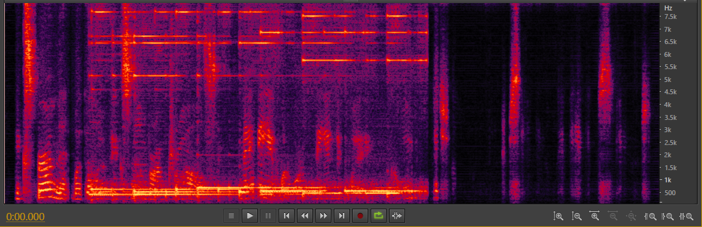
DEMO https://chenggangzhang.github.io/ICRN-AEC
（a）Microphone signal
（d）WebRTC-AEC3
（b）Target signal
（e）BLSTM
（c）ICRN
（f）CRN

Slide 14
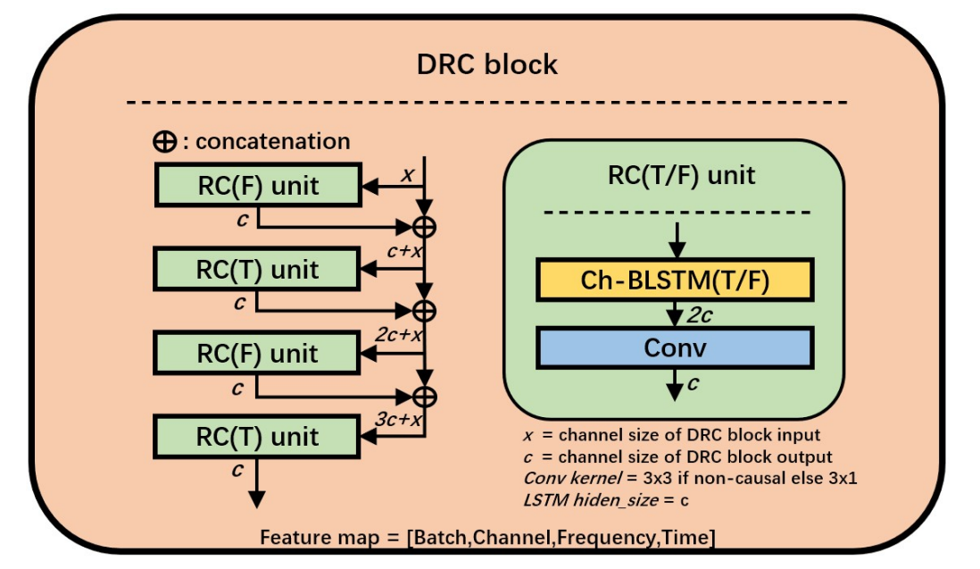
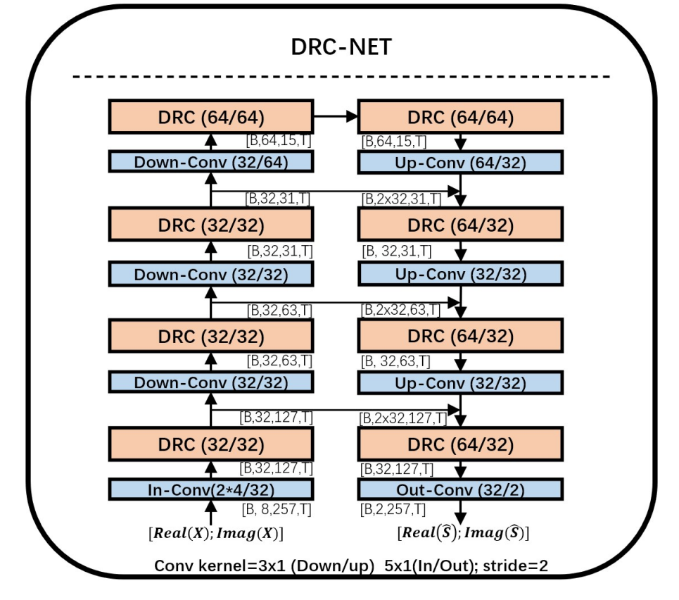
基于原地卷积的混响消除
DRC block
增加了时间维度的建模
频率维度: 双向 LSTM
时间维度: 单向 LSTM（确保因果性）
DRC NET
取消了原本CRN中的LSTM
保留了升、降采样卷积（方便平衡算力和模型参数量）

Slide 15
Experiments
实验设置
Speech corpus:
WSJCAM0
Reverberation simulation:
RIR generator (IMAGE method)
reverberation time (T60): 0.2s - 1.3s
Noise:
REVERB challenge noise
[5, 25] dB SNR
Microphones:
4-channel uniform circular mircrophone array
20cm aperture
Room configurations:
room length & width: [5,10]m
room height: [3,4]m
Speech source:
distence: [0.75, 2.5]m away from micropones
STFT:
32 ms frame length,
8 ms frame shift,
hann window
257-dimension complex spectrum
Evaluation metrics:
Extended short-time objective intelligibility (ESTOI)
Perceptual evaluation of speech quality (PESQ)
Signal-to-distortion ratios (SDR)
Notes:
This is the experimental setup.

Slide 16
结果
Jinjiang Liu, Xueliang Zhang, “DRC-NET: Densely Connected Recurrent Convolutional Neural Network for Speech Dereverberation,” ICASSP 2022, pp: 166-170.

Slide 17
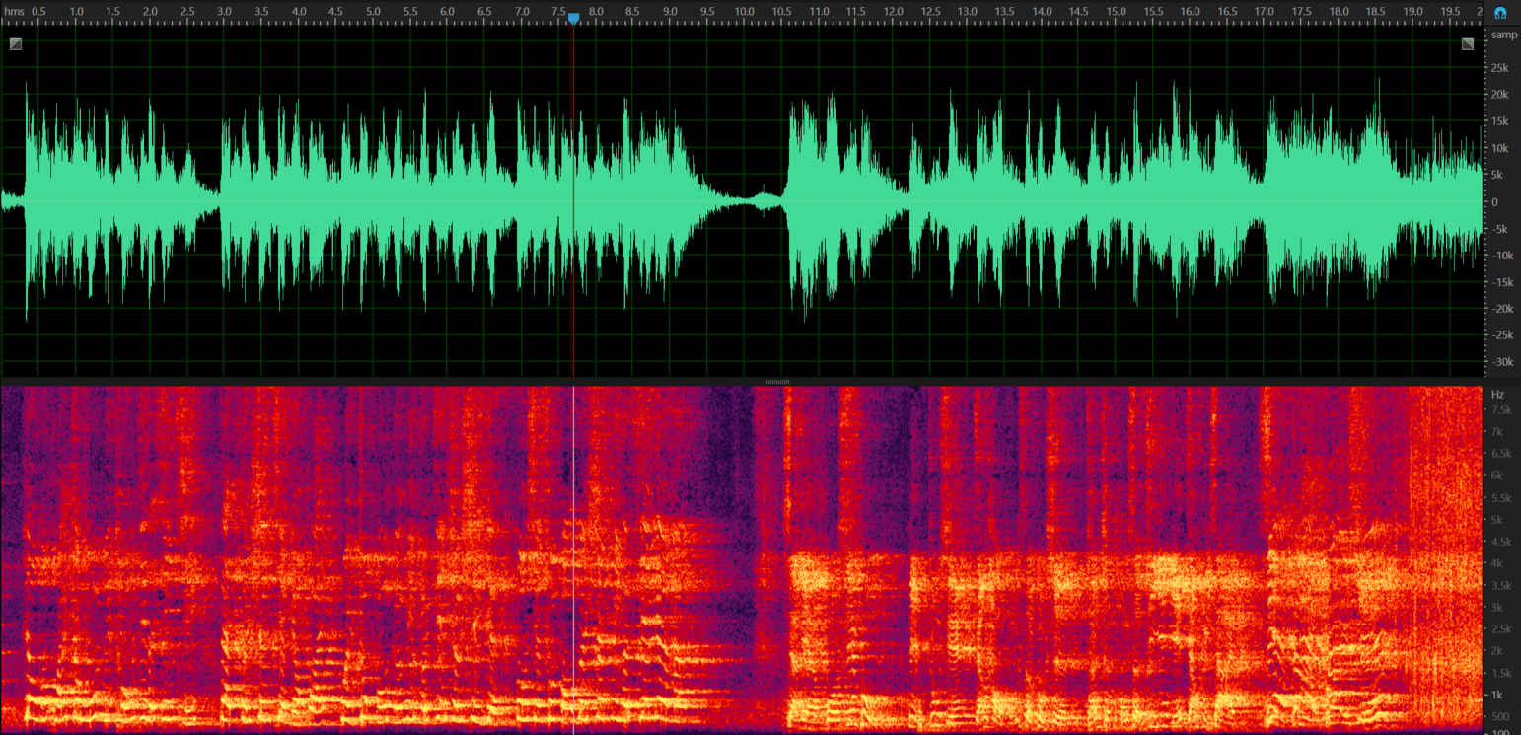
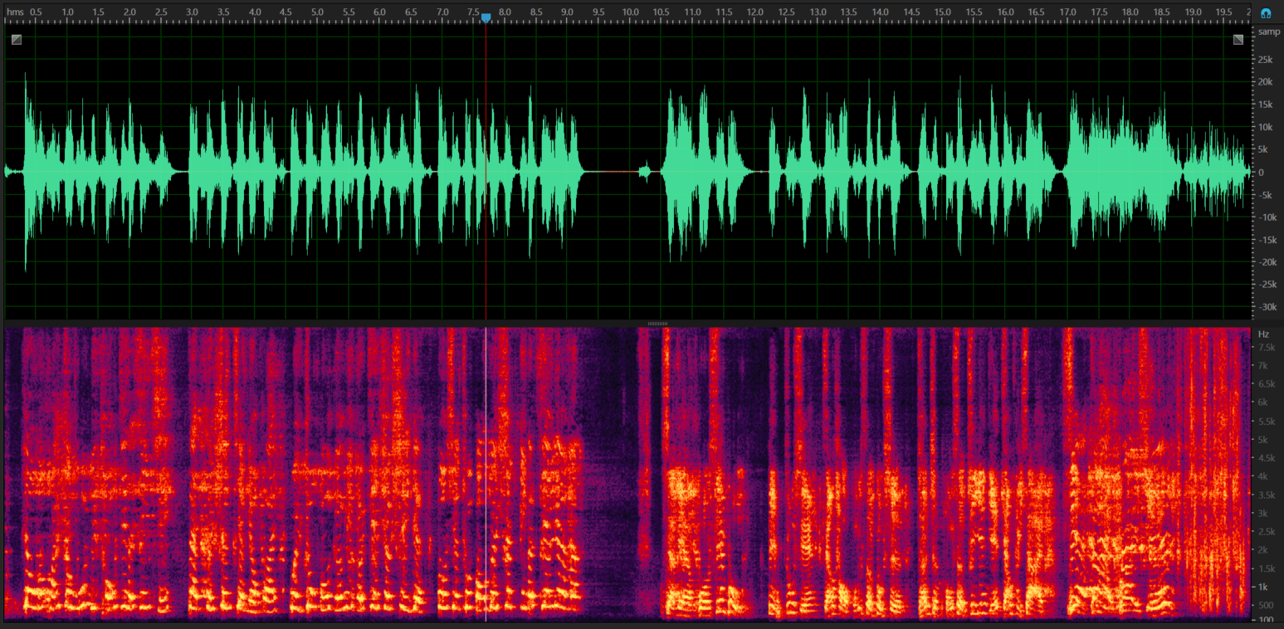
Tiny DRC-NET for laptop computer : 0.11G MAC 0.14M Param
Real Recording
Processed
Notes:
This is the experimental setup.

Slide 18
总结
受传统信号处理算法的启发，我们提出了inplace convolution和channel-wise LSTM的处理方式，提出了频带独立模型。
模型可以较好地保留输入频点的位置信息，降低了学习难度。
该模型和其扩展模型用于多通道语音增强、回声消除、混响消除等任务，均有良好表现。同时，有效的降低了模型的参数量。

Slide 19
谢谢

